Slide 1
Airbnb Property Amsterdam
Christopher Chiang

Slide 2
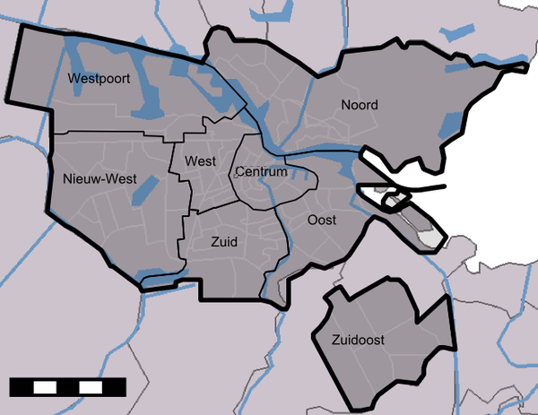
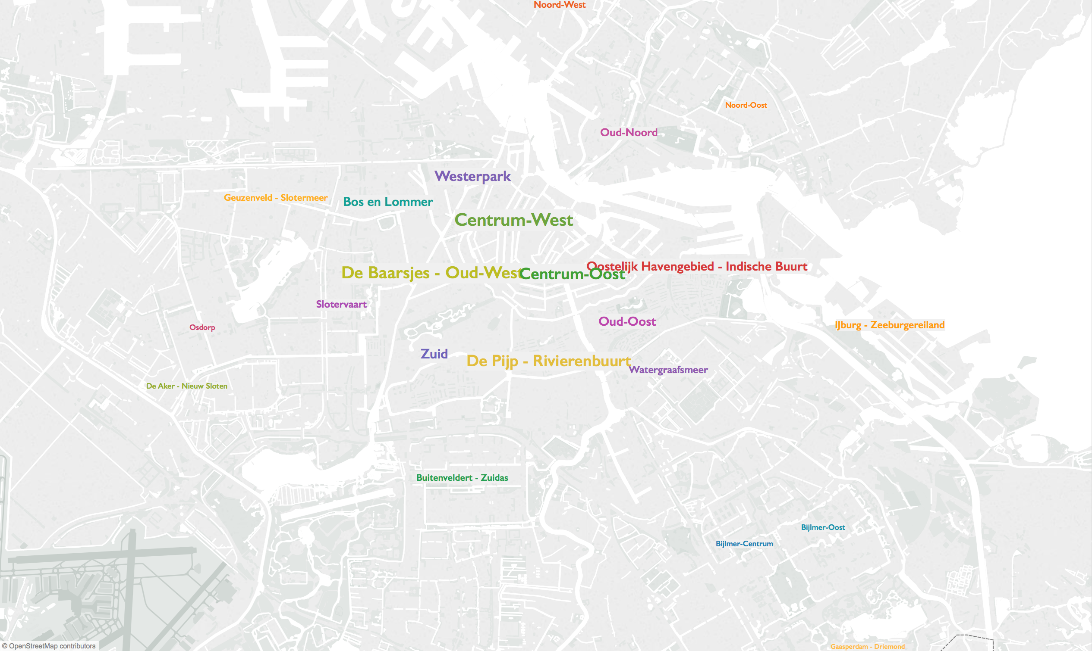
What neighborhood should you invest in?
What you have:
- a general idea of which borough
- an interest in an apartment or a house
What you want:
- a specific neighborhood to invest in
- a good amount of rental income from the property

Slide 3
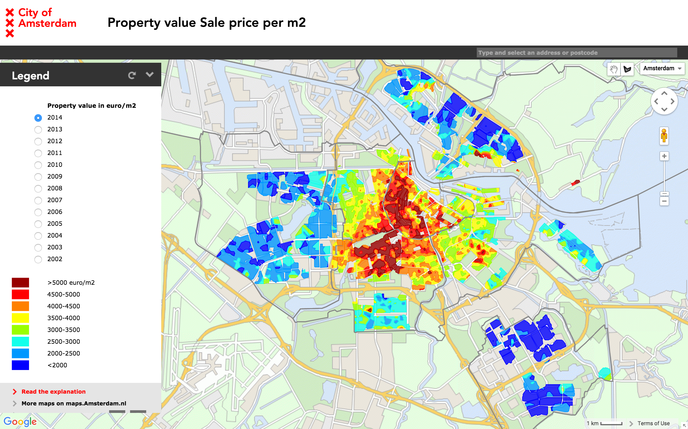
How do we find the neighborhood?
What information we have or will assume:
- don’t want a very expensive area
- want to buy a home or apartment
- rental income is important
- a graphic showing property values in Amsterdam
- a lot of numbers on rental data that can be used to calculate some numbers that we don’t have
- don’t want too much competition
What we are going to do:
- use our information to compare the options to find the best borough and then the best neighborhood in that borough

Slide 4
How do we use the all of the information we have?
Find the borough:
- compare average monthly income and possible competition or number of listings across boroughs
- check against property sale value to narrow the choice down to one borough
Then find the neighborhood:
- compare average monthly income, possible competition, average bookings per month, and count of property types across neighborhoods
boroughs
borough
neighborhood
8 boroughs
22 neighborhoods
1 borough
2-4 neighborhoods
1 neighborhood

Slide 5
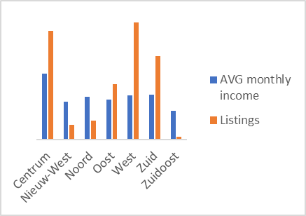
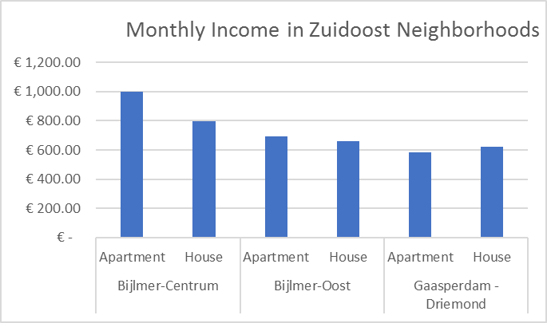
Which borough and neighborhood do we find?
Find the borough:
- want high monthly income with not too many listings
- Nieuw-West, Noord, and Zuidoost look like good choices
Then find the neighborhood:
- compare monthly income for apartments and houses and how many listings there are in these boroughs and neighborhoods
- can’t show all of the steps in one compact chart but out of the three boroughs and the ten neighborhoods, the best choice looks like Bijlmer-Centrum

Slide 6
Recommendation
Which borough?
Zuidoost
Which neighborhood?
Bijlmer-Centrum
Apartment or house?
Apartment
How much can you expect to earn?
Average of €1000 per month

